Slide 1
Rising 6th Grade Night

Slide 2
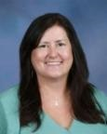
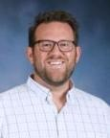
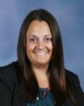
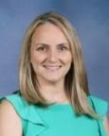
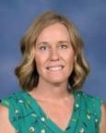
TCA Support Team
Katie O’Connell
Principal
David Barnes
Asst Principal
Sam Sawruk
Asst Principal
Lisa Paredes
Dean
Stacey Dobbins
School Counselor
Notes:
Stacy

Slide 3
Core classes (4)
English Language Arts (course recommendation)
Math (course recommendations automated based on PM2 and PM3 test scores)
Science (all students provided an opportunity for Advanced course work)
World History (all students provided an opportunity for Advanced course work)
Required non-Core classes (2)
Digital Discoveries
Physical Education
non-Core classes (1)
Band I
Art
Virtual
Notes:
Jacque

Slide 4
Physical Education
All 6th grade students take a full year of P.E.
Students cannot wear their school clothes to participate in Physical Education.
Every student must have a PE uniform – Uniforms will be available to purchase on a future date. Communication will be sent home!
Students must wear sneakers.
Students are given adequate time to change at the beginning and end of class.
Grade 6 Digital Discoveries
Students are encouraged to be curious, solve personally relevant problems and express themselves through creation. The course is designed to interweave lessons with discussions, presentations, peer feedback, and shared reflections. As students proceed through the pathway, the structures increasingly shift responsibility to students to formulate their own questions, develop their own solutions, and critique their work. The tools and strategies in this course will help teachers understand and address well-known equity gaps within the field. All students can
succeed in computer science when given the right support and opportunities, regardless
of prior knowledge.
Notes:
Amy

Slide 5
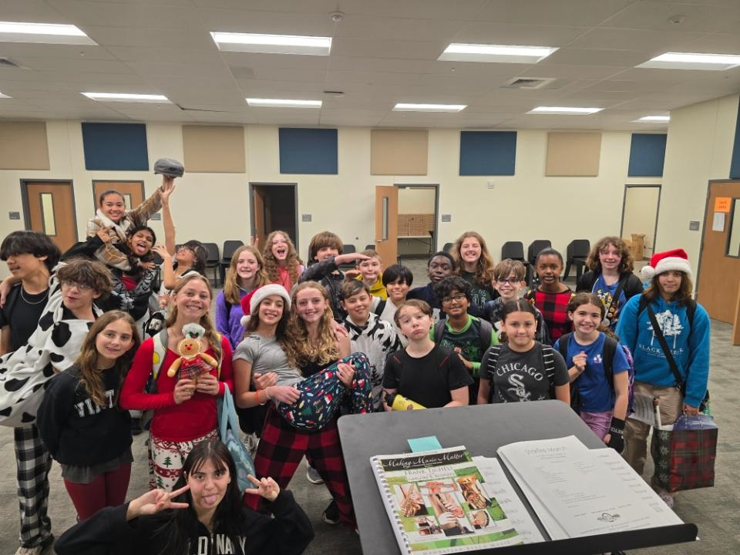
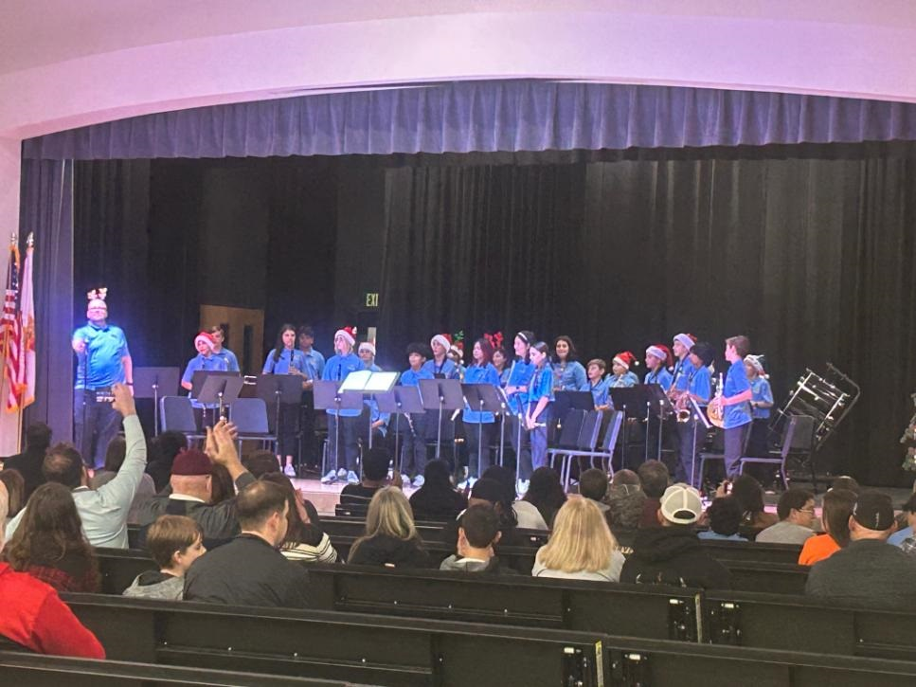
Beginning band
Parent permission is required to participate in Band.
A “try on” instrument session occurred today and will conclude tomorrow.
Please do not rent/purchase an instrument before consulting with Dr. Clasen-LeBlanc our band director.
Students will perform during a winter and spring performance.
Practice = Homework, students are expected to practice at least 20 minutes a day on their instrument.
Notes:
Stacy

Slide 6
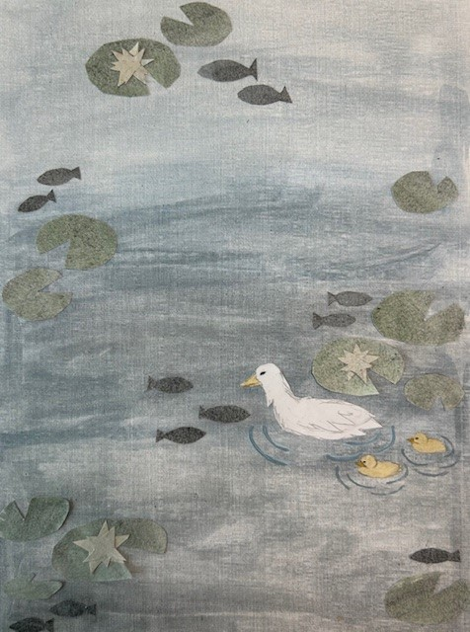
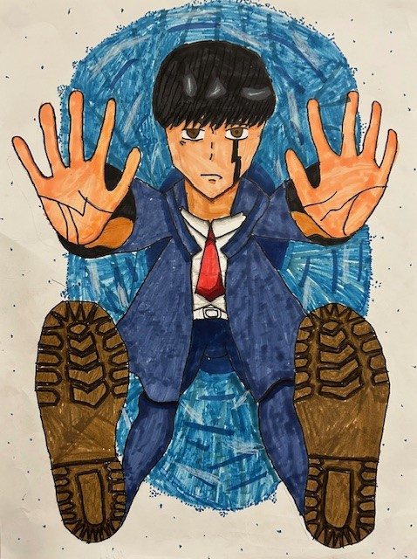
Art
Focus on exploring media and creating a variety of 2D artwork
Art design – drawing, painting, printmaking, and collage
Student work will be displayed on a regular basis.
Art is a fun opportunity for students to discover new talents and interests.
Notes:
Stacy

Slide 7
Virtual
Students would take a virtual course through Florida Virtual School or St. Johns Virtual School while on campus at TCA
Students go to a classroom supervised by a TCA staff member but engage with their online instruction and teacher
Some available courses include:
Digital Art and Design
Exploring Two-Dimensional Art
Exploring Music
Guitar
Business Keyboarding
Coding Fundamentals
Career Research and Decision Making
Critical Thinking
Notes:
Stacy

Slide 8
Scheduling Process
February 20 – Rising 6th Grade Night w/ course descriptions and process explanation. Course selection form distributed to parents.
February 24 – Students submit their signed course selection forms to their homeroom teachers.
February 26 – Students make their course selections via Home Access Center (HAC) in their Homeroom class.
Later in the year, parents will be able to confirm their students’ course selections via HAC as well as course recommendations made by teachers
Rising 6th Grade Night
Submit course request form
Complete HAC course requests
Parent review (date TBD)
Notes:
Stacy

Slide 9
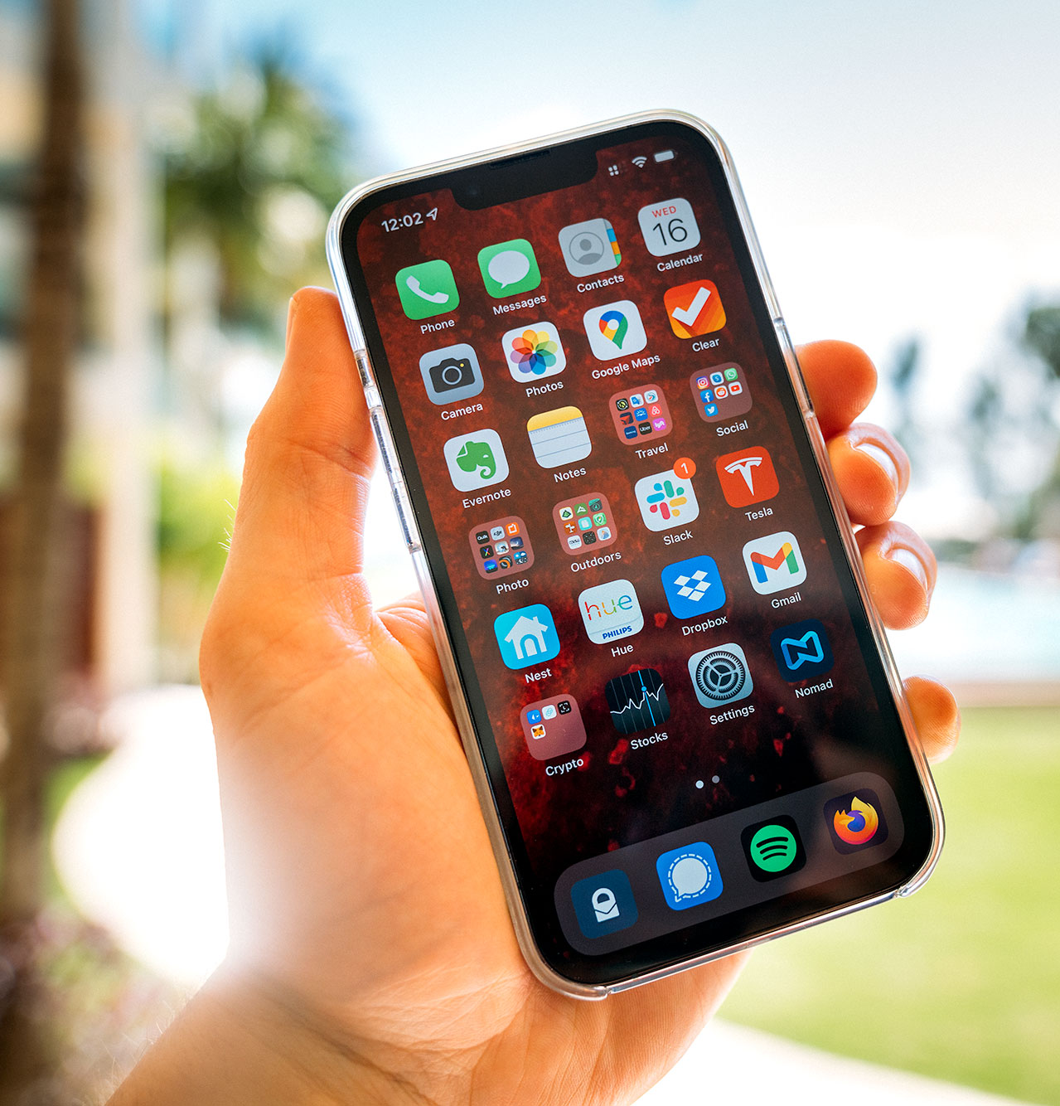
Technology devices & cellphones
Students are permitted to use cell phones during lunch
Cell phones and watches are always the student's responsibility
The school is not responsible for investigating lost, damaged, or stolen cell phones.
If students needs to communicate with a parent, they must do so through the front office
Videos/pictures of other students or staff is a serious violation of the SJCSD Student Code of Conduct
If there is reasonable suspicion of a violation of this expectation, school administrators/dean are permitted to search the student’s phone
Notes:
Stacy

Slide 10
Daily Schedule
7 Period Day – 4 min passing period between classes
Mon, Tue, Thur, Friday Schedule
45 min periods
Wednesday Schedule
30 min periods
Remediation Block
Lunch – 30 min daily
Middle school students will have lunch together divided between two lunch blocks
Students will choose their own seating during lunch time.
Students report to 1st period each day by 8:00 am for important morning announcements.
Notes:
Crystal

Slide 11
Communication
Schoology is the main source of communication (calendars, announcements, individual messages, etc.)
Online textbooks are available for all core classes
Usernames and passwords are the same for all accounts (Clever)
Organization is the key to success!
It will be the responsibility of the student to choose the best way to stay organized, using a planner and Schoology.
Parents will want to check their child’s Schoology daily to assist the child in the development of organizational skills
Notes:
Ken

Slide 12
Questions?
I am happy to answer individual questions after the presentation
Thank you!
David.Barnes@stjohns.k12.fl.us
stacey.dobbins@stjohns.k12.fl.us

